Slide 1
International football results from 1872 to 2019
Parameshwari S
CB.SC.I5DAS18026

Slide 2
Introduction
This Case Study mainly focuses on Data visualisation in Python to build analytical results and to produce some visual displays of the dataset. Main objective of this case study is to summarize thousands of rows of dataset in one picture using elegant visualisations.

Slide 3
Data Explanation
41,590 results of international football matches from 1872 up to 2019.
FIFA World Cup, UEFA Euro League, and regular friendly matches.
Data format
date - date of the match
home_team - the name of the home team
away_team - the name of the away team
home_score - full-time home team score including extra time, not including penalty-shootouts
away_score - full-time away team score including extra time, not including penalty-shootouts
tournament - the name of the tournament
city - the name of the city/town/administrative unit where the match was played
country - the name of the country where the match was played
neutral - TRUE/FALSE column indicating whether the match was played at a neutral venue

Slide 4
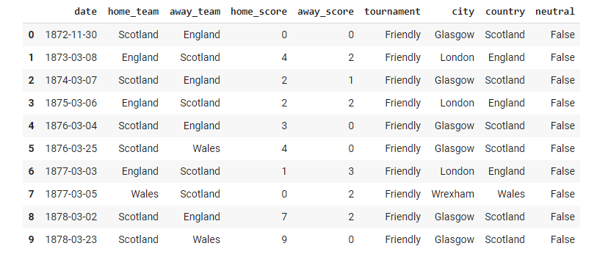
Sample dataset
Sample dataset
Challenge 1
Challenge 2
Challenge 3

Slide 5
Modules and Packages
Matplotlib
Seaborn
Plotly
folium
statsmodels.graphics.mosaicplot
squarify
geopy.geocoders
numpy
math
pandas
datetime

Slide 6
Implementation

Slide 7
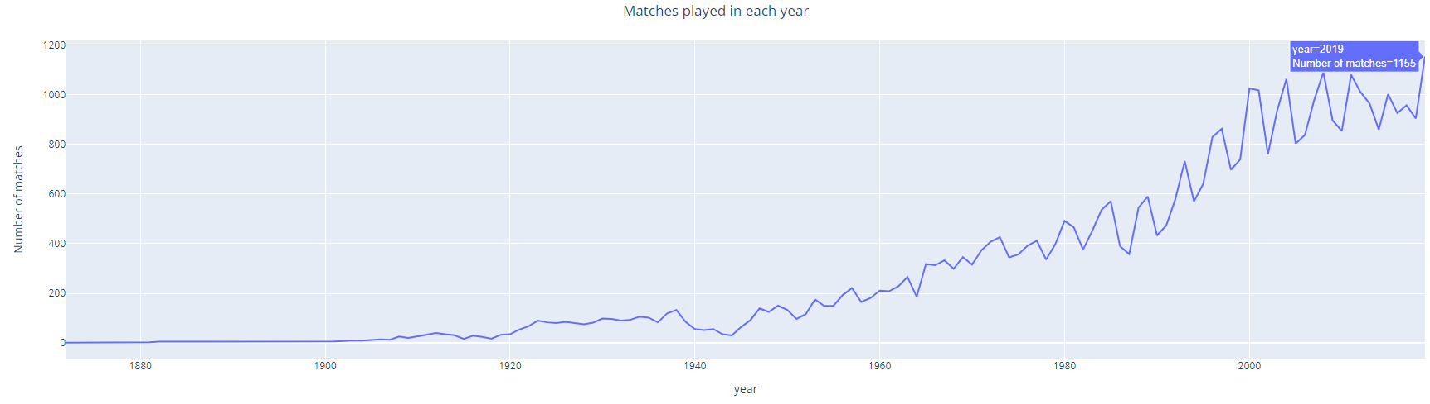
1. Evolution of football
Plot used - Line plot (Represents quantitative continuous independent with dependent variable)
Inference - From this graph, we can infer that number of games is rising over the years with highest growth in 1980’s and there is a peak in 2019 with 1155 matches played. We can also get total number of matches played in each year.

Slide 8
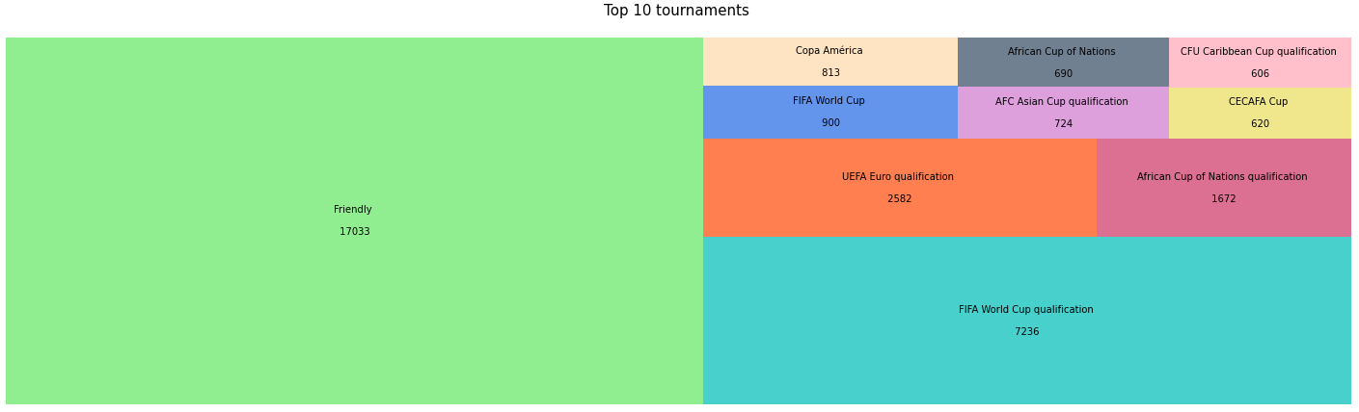
2. Top 10 tournaments with most number of matches
Plot used - Treemap (part to whole relationship among categories)
Inference - We get the first 10 tournaments that has been played most over the time along with number of matches. Among those ten, Friendly matches covers around 50 percentage of the whole which means those matches has been played the most. The next leading tournament if FIFA World cup qualification which cover around 20-25 percentage of the whole. Rest of the tournaments covers only around 30 percentage of the whole.

Slide 9
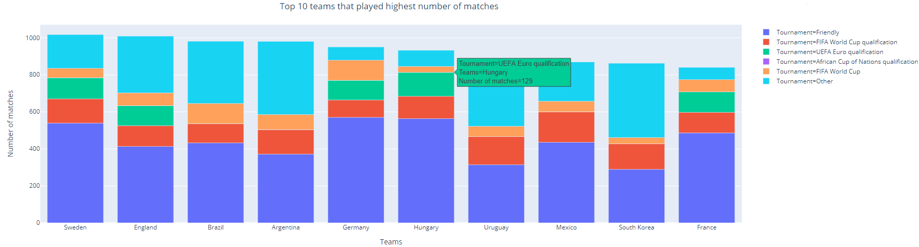
3. Team that played most number of matches
Plot used - Stacked bar chart (Comparing contributions made by secondary categorical variables for different categories)
Inference - Sweden has played more number of matches till date followed by England and Brazil. We can see the contributions made by the top 5 tournaments to all the teams. Like seen before, Friendly matches has been played most by all the teams. Euro qualifications and African Cup qualifications has been played by the respective country teams.

Slide 10
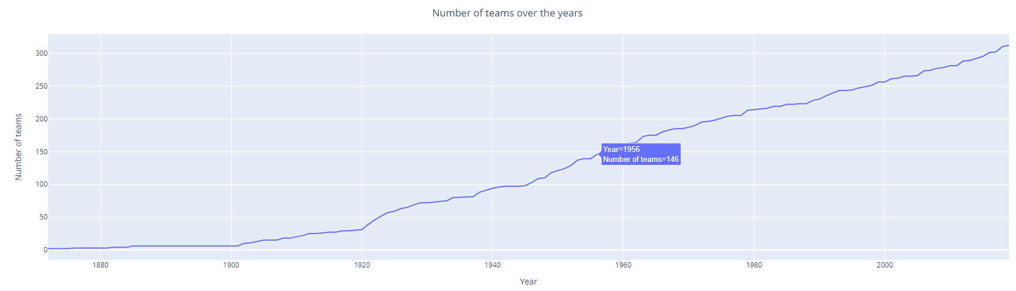
4. Number of teams over the years
Plot used - Line plot (Represents quantitative continuous independent with dependent variable)
Inference - We can see the cumulative increase in teams over the years. There are 312 teams till 2019. There is a sudden increase in the graph from 1920s which means that football became more famous and accepted by more part of the world from 20th century.

Slide 11
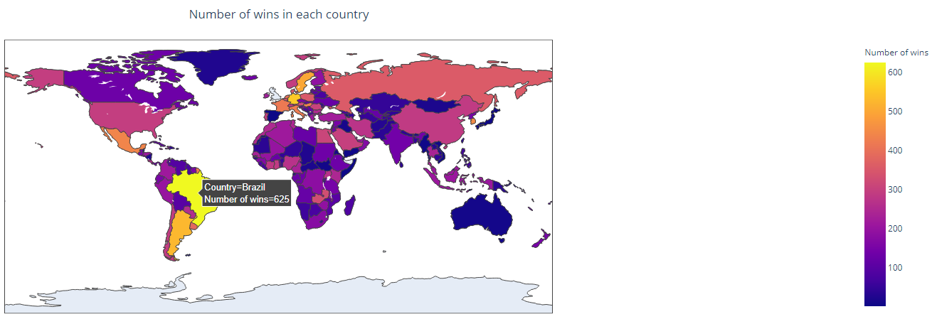
5. Number of wins in each country
Plot used - Choropleth map (Comparing statistics of spatial data)
Inference - From this graph, we can easily find the countries with most and least wins by looking at the shades. Brazil is the leading country followed by Argentina, Mexico and some European countries. Asian and African countries have won less number of matches compared to Europe and America.

Slide 12
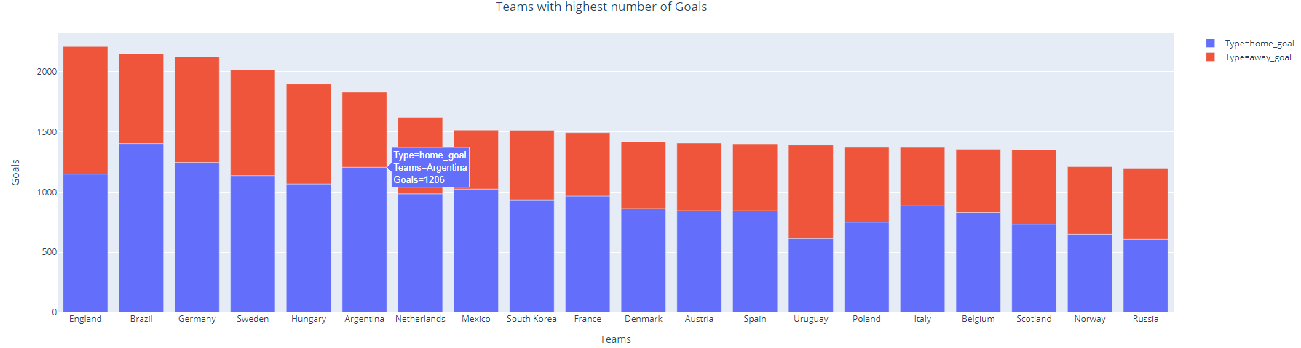
6. Teams with highest number of goals
Plot used - Stacked bar chart (Comparing contributions made by secondary categorical variables for different categories)
Inference - We get top 20 teams that scored highest number of goals. England scored highest goals till date followed by Brazil and Germany. We can also note that almost all teams have scored more home goals that away goals which means all teams perform well in their home ground as they have good support.

Slide 13
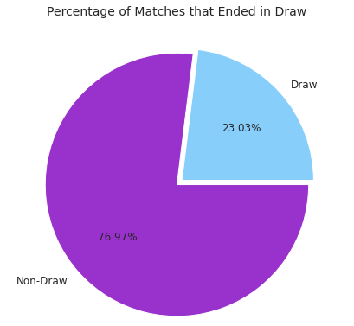
7. Percentage of matches that ended in draw
Plot used - Pie chart (Compares relative portions of a quantitative dependent variable of a single dimension)
Inference - We can see the percentage of matches that ended in draw till date, only 23 percentage of matches ended in draw which means around 9500 matches has been tied out of 41590 and remaining matches are non-tied matches. Probability of a match getting tied is very low.

Slide 14
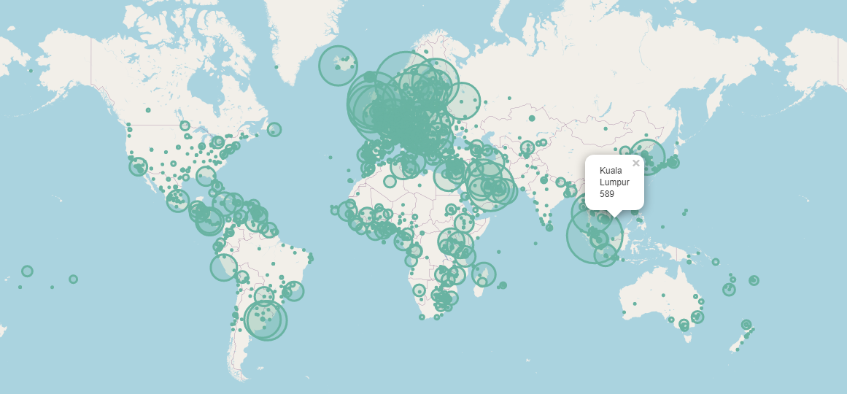
8. Number of matches hosted by different venues
Plot used - Bubble map (Representing some value using circle as the marker for locations on spatial data )
Inference - Based on the bubble size we can compare number of matches hosted by different locations. European countries have hosted more number of matches than other continents. Places where no or less bubbles can also indicate less number of football lovers. (Russia, Canada, etc)

Slide 15
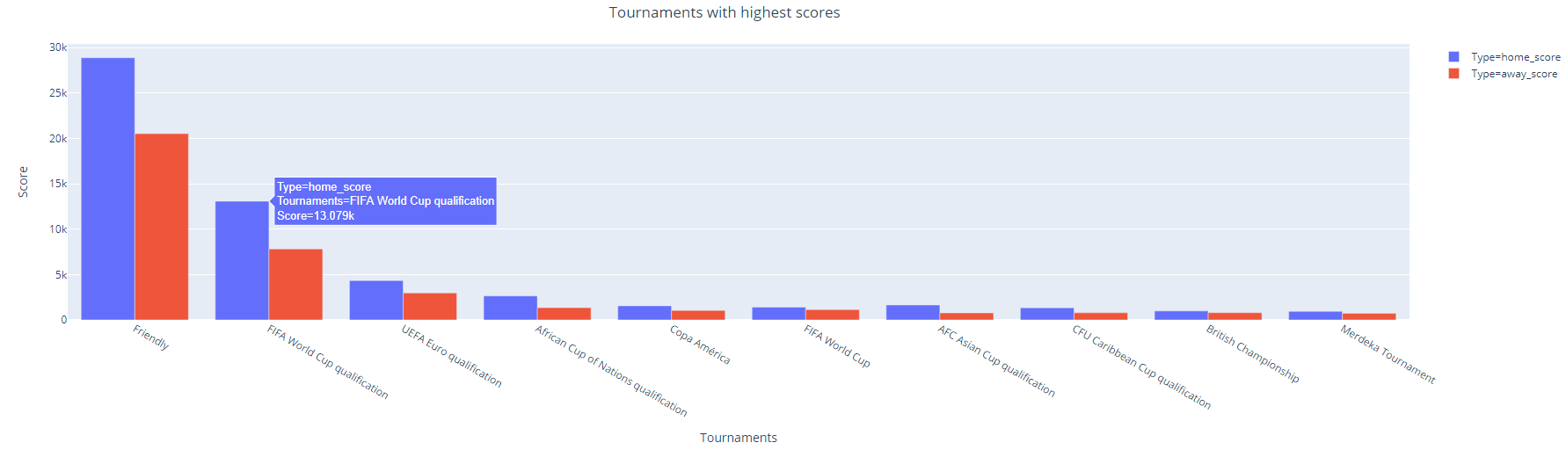
9. Home score vs Away score for each tournament.
Plot used - Double bar chart (Represents the data using two different categories)
Inference - Goals scored in Friendly matches are highest as number of friendly matches are more. Home goals are more in all tournaments that is teams playing in their home ground score more goals than when playing in other venues. We can say that probability for home team winning is high.

Slide 16
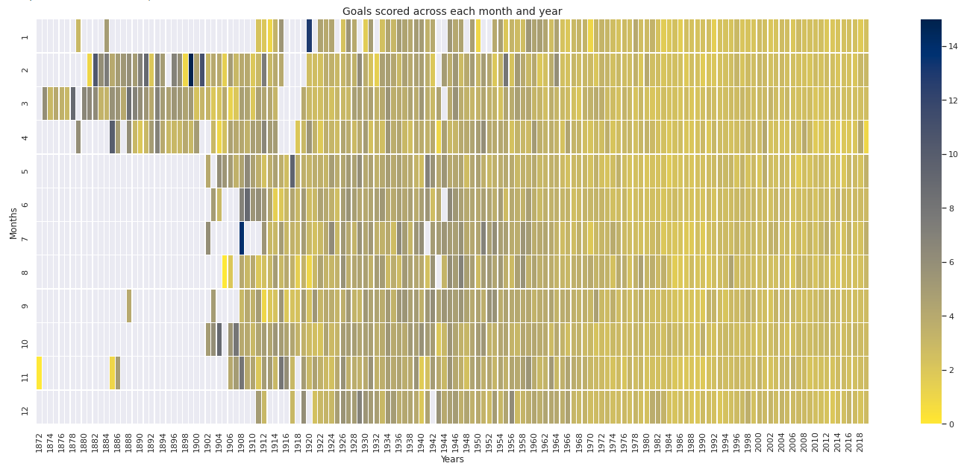
10. Evolution of goals scored
Plot used - Heatmap (generalised view of numeric values for large volume of data)
Inference -There is a drastic increase in number of goals after football started. For first few years matches occurred mostly during February to April but then it gained popularity and played throughout a year. Before 1900 the average goals were around 8, from 1900s to 1950s the average goals became around 4 and now it has decreased even more to 2-3. This tells that teams became more competitive over years.

Slide 17
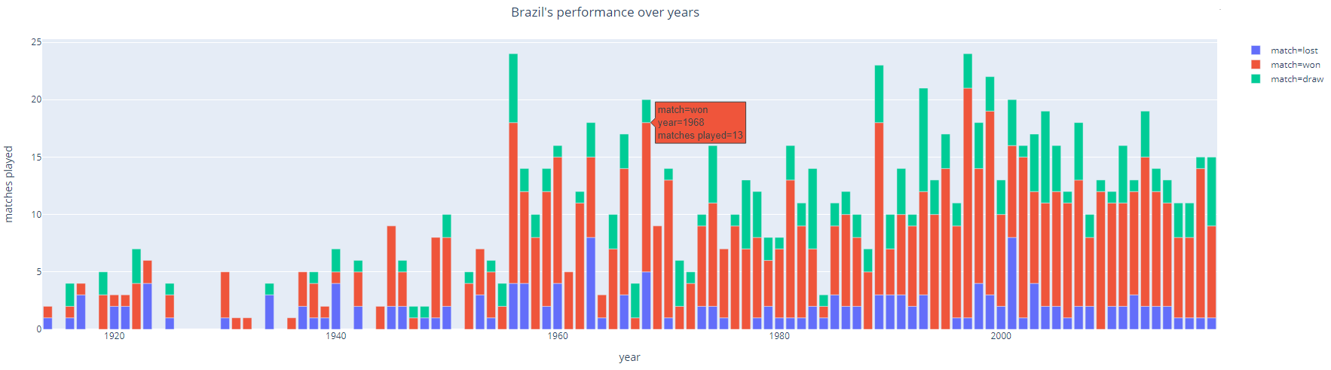
11. Brazil's performance over years
Plot used - Stacked bar chart (Comparing contributions made by secondary categorical variables for different categories)
Inference - We can easily understand why Brazil is one of the best football team by looking at this plot. Number of wins is higher than matches lost and tied in almost every year. To be accurate, we can see that even matches lost is lesser than matches tied. So we can understand Brazil is one of the toughest team to win.

Slide 18
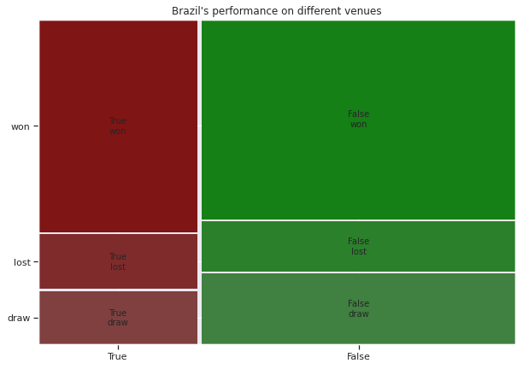
12. Wins-Losses for Brazil on different venues
Plot used - Mosaic plot (Represents the association between two or more categorical variables)
Inference - We can see that matches won are more than matches lost and tied, and also they have more number of wins on non-neutral venue which means they perform well either in their home ground or away ground. We can also see that matches tied are more than matches lost. We can infer that Brazil is one of the best Soccer team.

Slide 19
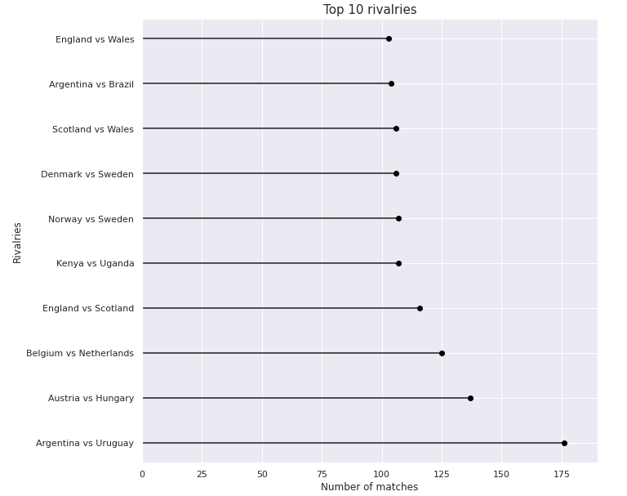
13. Top 10 rivalries and their performance
Plot used - Lollipop chart (bar chart with different visual representation)
Inference - Argentina and Uruguay has played more number of matches as opponents(around 175 matches) followed by Austria vs Hungary and Belgium vs Netherlands. This also means audience enjoy watching these teams play as opponents.

Slide 20
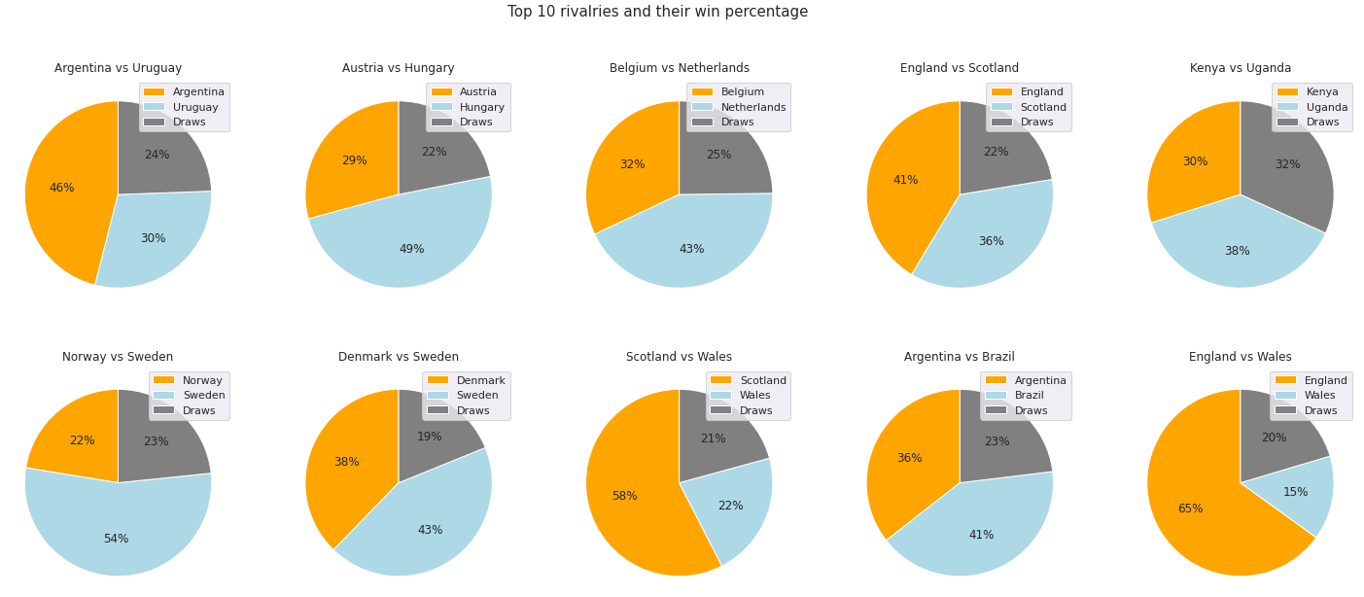
Plot used - Multiple pie charts (to visualize and compare data of a category across different groups)
Inference - We can get the win percentage of top 10 rivalries. Wales is one of the teams in top 10 rivalries but their performance is not so good, they have very low win percentage. Teams performing as opponents of Wales have performed well. The best rivalry is Denmark vs Sweden as their difference between win percentage is very low, we can say both the teams are strong and give their best whenever they play as opponents.

Slide 21
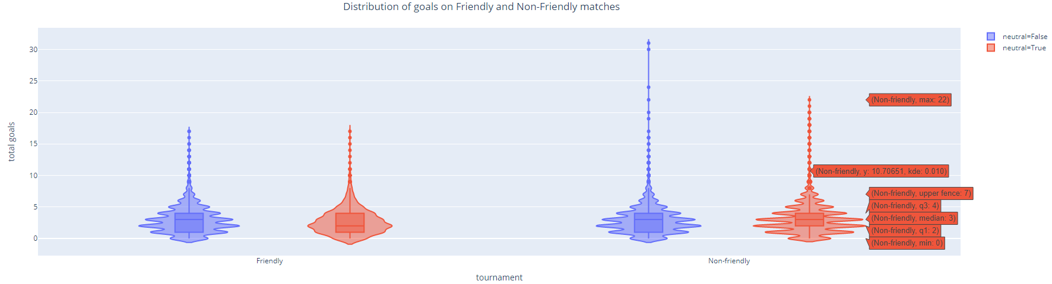
14. Distribution of goals in Friendly vs Non-Friendly matches
Plot used - Violin chart (Represents distribution of a numeric data)
Inference - We get the distribution of goals in different venues for Friendly and Non-Friendly matches. The shape of this plot tells that it is a multimodal function that is they have more than one mode. And we can also tell that highest recorded goals are from Non-Friendly matches, teams get more competitive in Non-friendly matches.

Slide 22
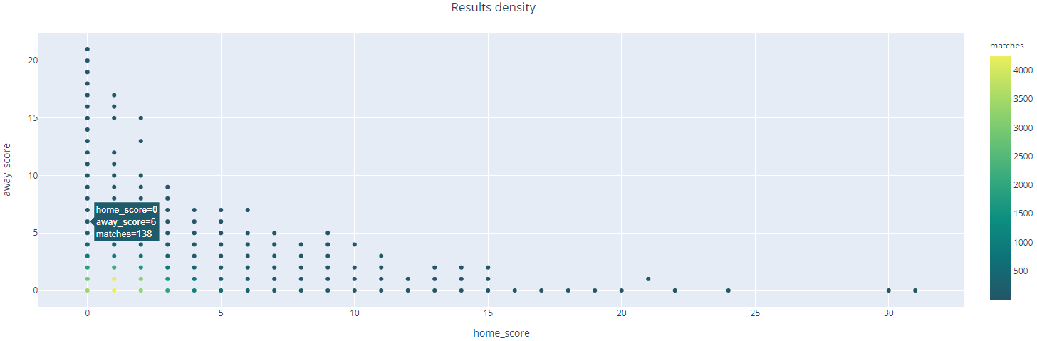
15. Results density
Plot used - Scatter plot (Represents two quantitative independent variables)
Inference - By looking at the color of the dots we can say that in more than 3000 matches total goals scored is around 2-3 per match. Dots are more accumulated at bottom left which means more number of matches have less total goals per match and dots are scatter at top left and bottom right which means very few matches have more total goals per match. We also get the number of matches with respective home scores and away scores.

Slide 23
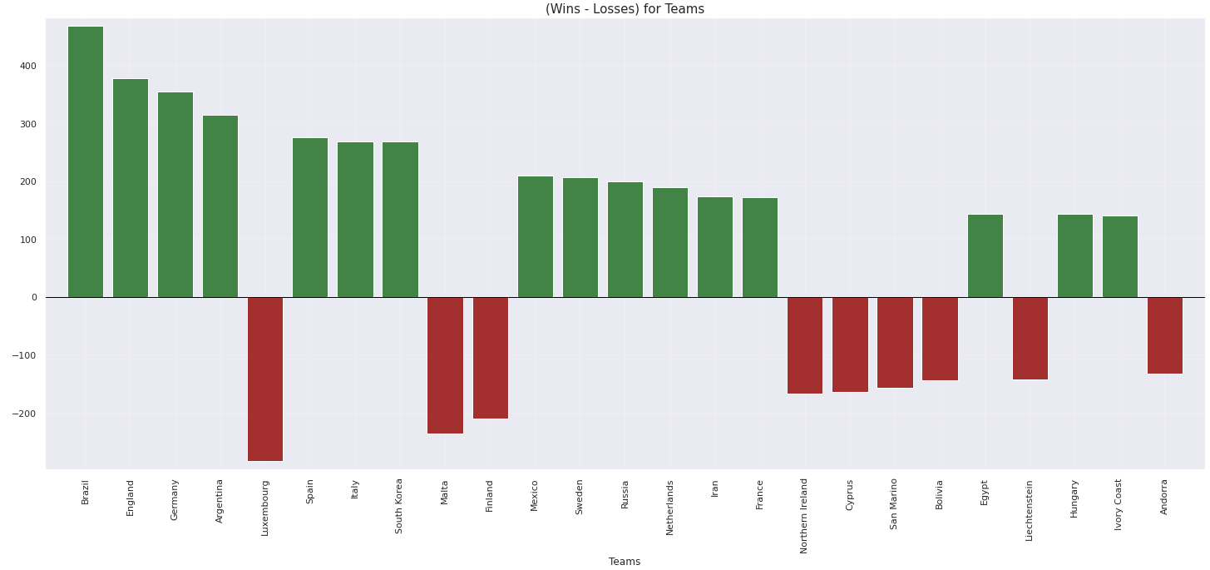
16. Teams with absolute (Wins-Losses)
Plot used - Positive Negative bar chart (Represents positive and negative development for different categories)
Inference - This graph shows top 25 countries with highest absolute difference between wins and losses. The bars above the x axis represents that those countries have won more matches than they lost whereas bars below the x axis represents these countries have lost more matches than they have won. We can say that Brazil is the best soccer team and Luxembourg is the worst.

Slide 24
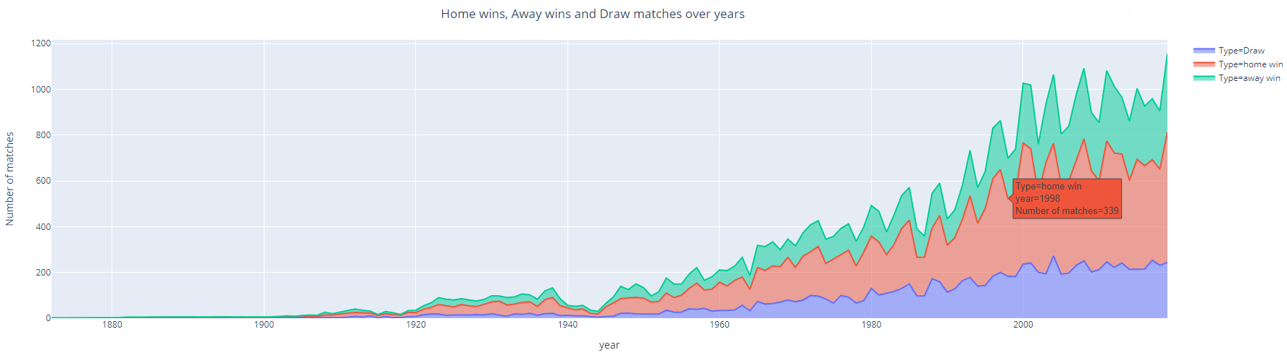
17.Home wins, Away wins and Draw matches over years
Plot used - Stacked Area chart (Demonstrates trends over time, filled area can give a greater sense of the trends of the data)
Inference - Area below red line is more compared to blue and green which means home team winning is high over the years, they have good support in their home ground and they would have practiced well in the same ground which results in their performance. Draw matches are less compared to lost matches.

Slide 25
Thank You

